Slide 1
Sequences and Summations
What do you mean by sequence?
Why we need summations?

Slide 2
Sequences
A sequence is a discrete structure used to represent an ordered list. For example, 1, 2, 3, 5, 8 is a sequence with five terms and 1, 3, 9, 27, 81 , . . . , 3n, . . . is an infinite sequence

Slide 3
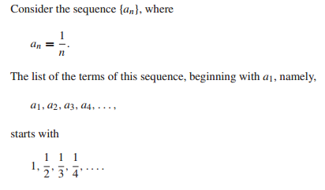
Sequence example

Slide 4
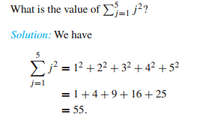
Summations

Slide 5
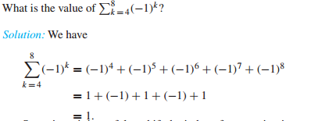
Summations

Slide 6
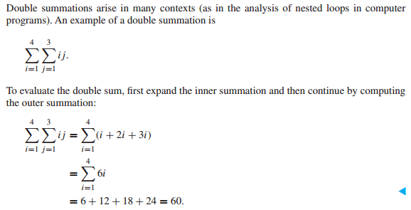
Summations(How double summations are similar to nested loops?)

